Slide 1
Meeting 9

Slide 2
What I did
Skimmed the C codebase
It’s essentially identical to the pseudo-code
Not very important to hardware implementation, I think.
Will be useful for data verification.
Read the CRYSTALS-Kyber math paper
I tried but the math proofs are a bit too hard
Read some hardware implementation of CRYSTALS-Kyber
Not finished
Notes:
I DID read the paper, and the proofs, but it’s not very relevant for now, just know the mathematicians did the calculation and statics and they said it’s correct enough.

Slide 3
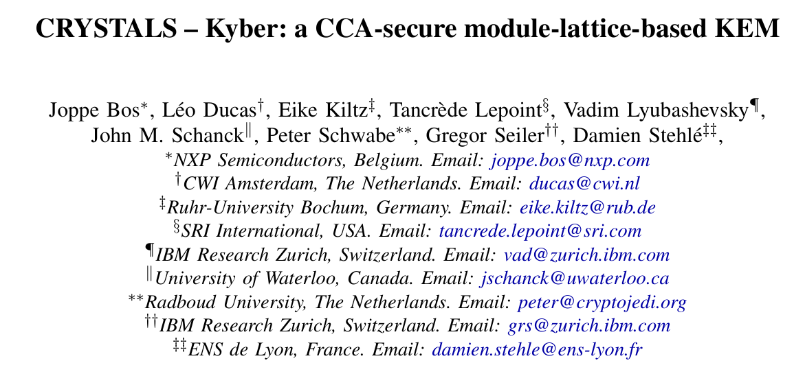
About the CRYSTALS-Kyber paper…
Notes:
So uhh, I read the paper and the math kind of confuses me. But the key takeaway of the paper is the proofs to the security of CRYSTALS-Kyber as a PKE (public key encryption) and transformed into a KEM (key encapsulation mechanism). Proving them to be secure under CPA (Chosen Plaintext Attack) and CCA (Chosen Ciphertext Attack)

Slide 4
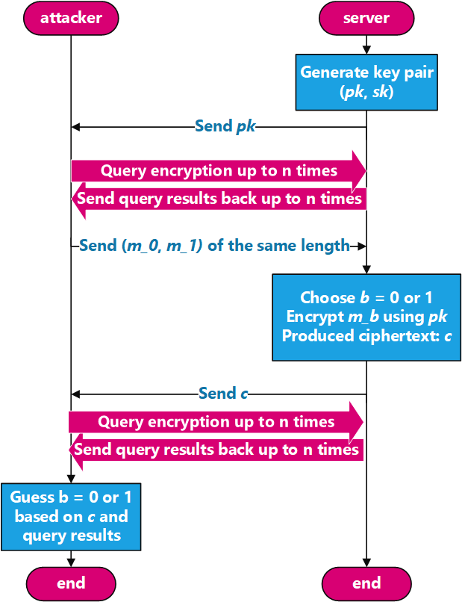

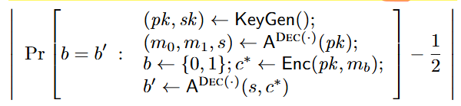
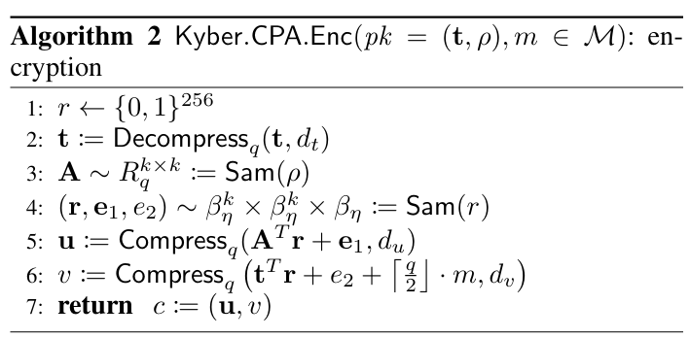
IND-CPA (In-distinguish-ability under Chosen Plaintext Attack)
Notes:
This proves the IND-CPA (indistinguishability under chosen plaintext attack) security for Kyber.PKE (Kyber.CPA in the original paper published in 2017).
The “Chosen Plaintext Attack” means an attacker can choose plaintexts and send it to encryption, collect the responded ciphertext, and analyze the result. If the encryption process is strictly deterministic (no randomness is involved), then the scheme is clearly not IND-CPA secure. Since the attacker can find clear indication between a ciphertext and plaintext, the attacker can easily win the guessing game described below.
The attacker knows the public key. The goal of the attacker is to find the corresponding ciphertext to the plaintext. Since the encryption process of Kyber.PKE is not deterministic, because of the random number r and the pseudo-random number it generated (r, e_1, e_2), the attacker cannot calculate the corresponding ciphertexts of m_0 and m_1 with the public key without knowing the random number r. The attacker will not be able to make an accurate guess.

Slide 5


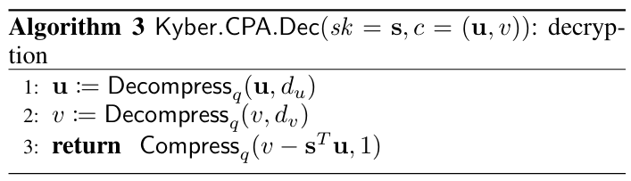
IND-CCA? (In-distinguish-ability under Chosen Ciphertext Attack)
secret key leaked ☹
Notes:
Now we give the attacker the ability to query the decryption, but not indefinitely. Since the attacker has the public key, the attacker can send ciphertexts and request the server to decrypt it. Since the decryption process expose the secret key, and some malformed ciphertext can easily reveal the secret key (such as crafting specific (u,v) that simply returns s which is the secret key). Therefore the Kyber.PKE scheme is not IND-CCA secure, the attacker requesting arbitrary ciphertext (chosen ciphertext) will hinder the security of the secret key.

Slide 6
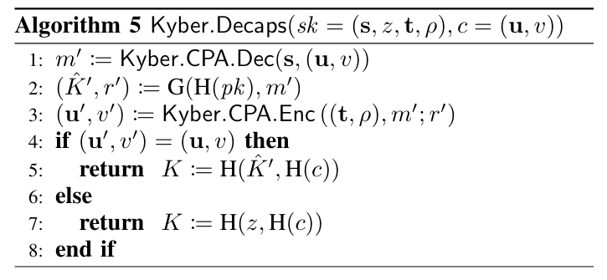
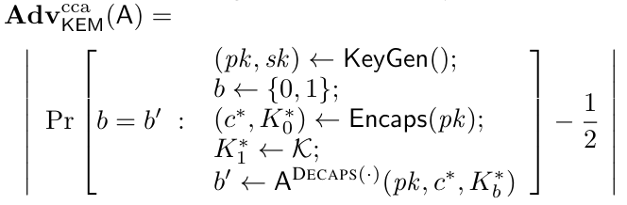
To achieve CCA-secure → KEM (Key Encapsulation Mechanism)
Bad ciphertext c that will cause decryption failure
Implicitly rejected ciphertext without exposing the secret key
re-encryption: c’ (line 3)
Very likely: c ≠ c’
Output a “not key” (line 7)
Notes:
To remedy this flaw, the research team use a tweaked FO-transform (basically using hash functions to make the encapsulation key), implicitly rejecting any malformed ciphertext. By re-encrypt the ciphertext c* using the derived message m’ thus no more leak to the secret key. Since querying decapsulation with arbitrary ciphertext, even with the ones that cause decryption failures for Kyber.PKE (Kyber.CPA), will be implicitly rejected and returned a K calculated from random number z and the querying ciphertext. The scheme is secure against chosen ciphertext attack.

Slide 7
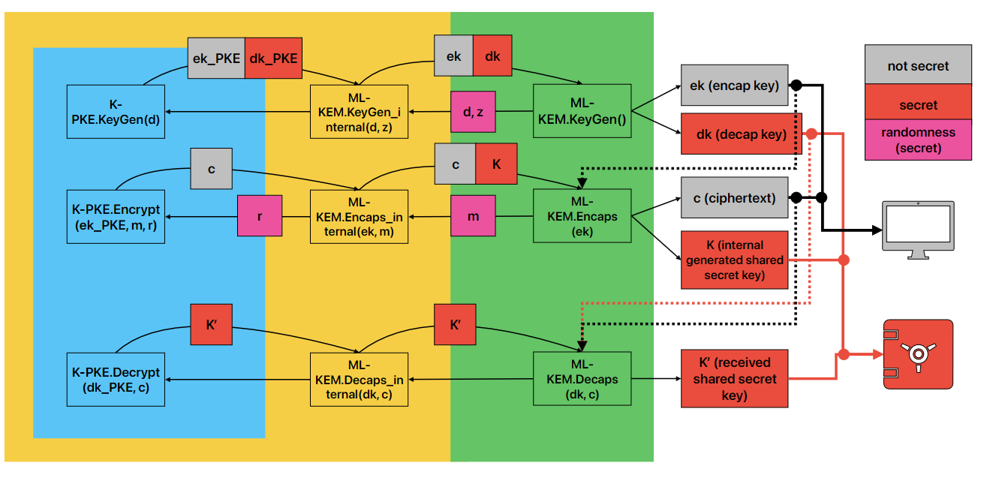
Thus, the layers for ML-KEM in FIPS 203
PKE
KEM
API with random number generator

Slide 8


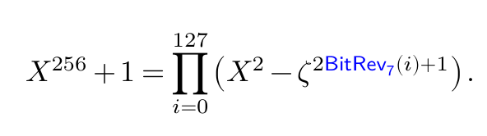
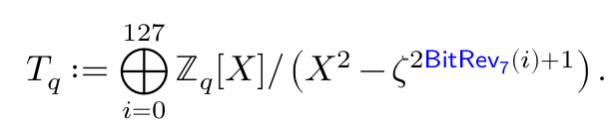
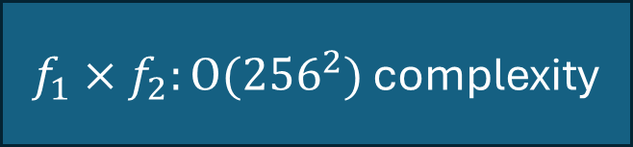
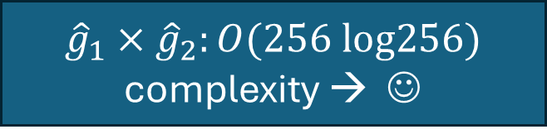
About Number Theoretic Transform (NTT)
$f_{1}×f_{2}:O({256}^{2})$ complexity
${\hat{g}}_{1}×{\hat{g}}_{2}:O(256 log256)$ complexity → ☺
Notes:
I kept being told it’s Discrete Fourier Transform, but I haven’t understood where the DFT lies.
But I now know WHY they can be transformed back and forth. I think.
Because the modulo X^256+1 is isomorphic to a X^2 polynomial multiples.

Slide 9
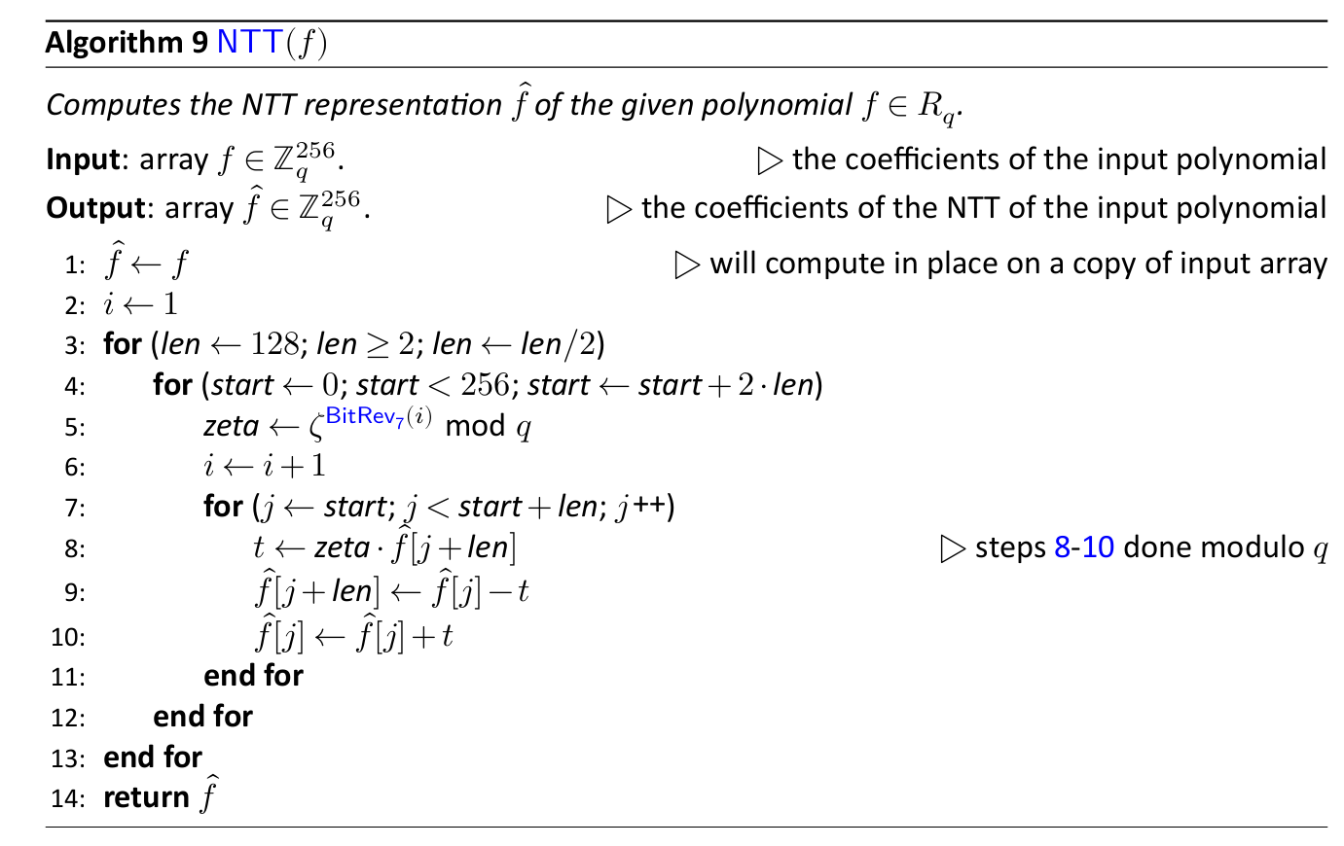
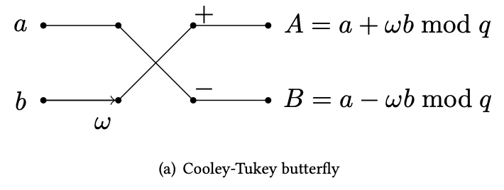
The algorithm for NTT
Notes:
There are two algorithms (Cooley-Tukey and Gentleman-Sande) that are used to implement Fast Fourier Transform (DFT but fast) I read about in the hardware implementation papers, but not at all mentioned in the math papers. I’m still figuring it out how it works while reading other purely hardware stuffs.

Slide 10
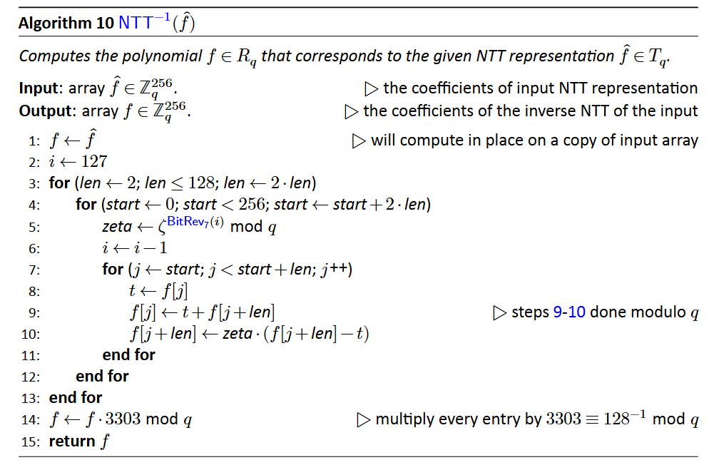
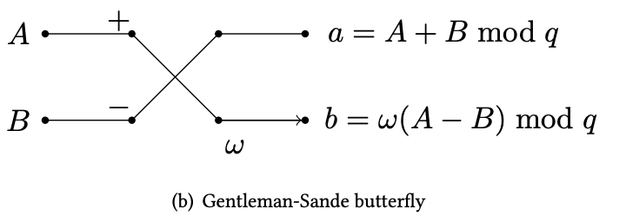
The algorithm for inverse NTT

Slide 11
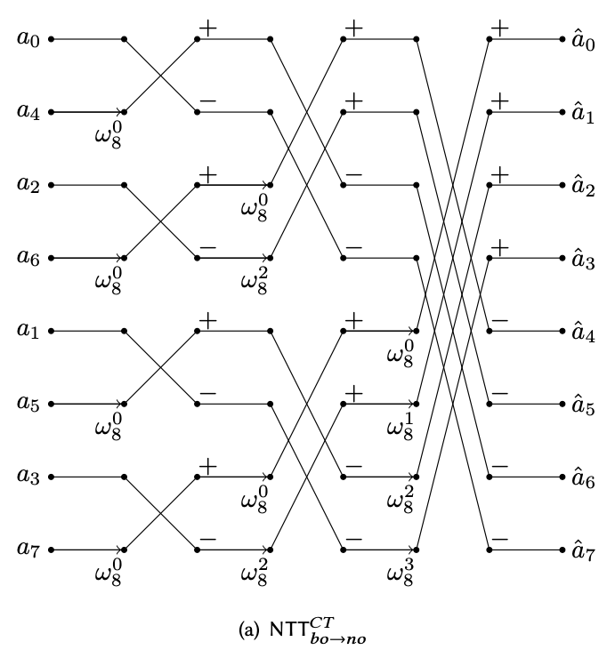
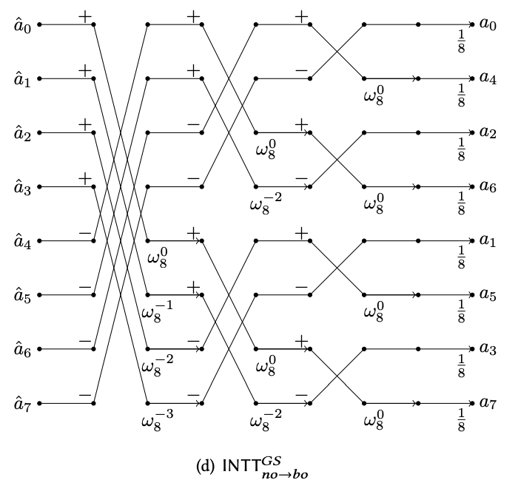
Cooley-Tukey and Gentleman-Sande “butterfly”

Slide 12
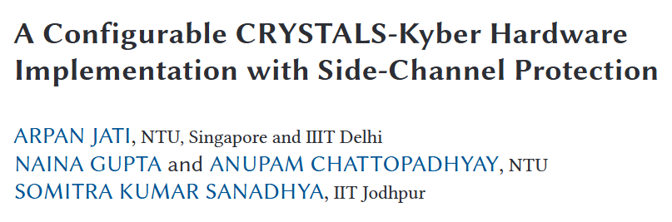
The hardware implementation paper that I’m still reading
Notes:
The paper is an ASIC design that’s more resembling a microprocessor with its own instruction set. It’s useful in terms of the fact it provides much insight about where the side channels are, and the references are aplenty. I don’t think its architecture helps a lot since I’m aiming to implement on FPGA

Slide 13
What needs to be done next
Hardware modules for the math operations (NTT, modulo, etc)
Read more about past hardware implementations
Attacks and mitigations on hardware implementations

Slide 14
Thanks for listening
:P

